Slide 1
TOPIC: SIMPLE LINEAR REGRESSION
GROUP MEMBERS:
ALI SARWAR(b18158030) - page # 3 (SLIDE # 2-15 )
ZOBADRESH AZFAR(B18158068) - page # 4 (SLIDE # 16- 20)
E-COMMERCE PROJECT DEMO:
KAINAT ZULFIQAR(B18158020) - (SLIDE # 21-36 )
JAVERIA ALI(B18158018) - (SLIDE # 37- 40)

Slide 2



RESIDUAL:
The residuals “ei” are the deviations of each response value “Yi” from its estimate value “Ŷi” :
Where:
Fr example:
The following graph demonstrates it:
is “ Error Term ” or “ Residual ”
is “ Observed Value ”
is “ Estimated Value ”

Slide 3
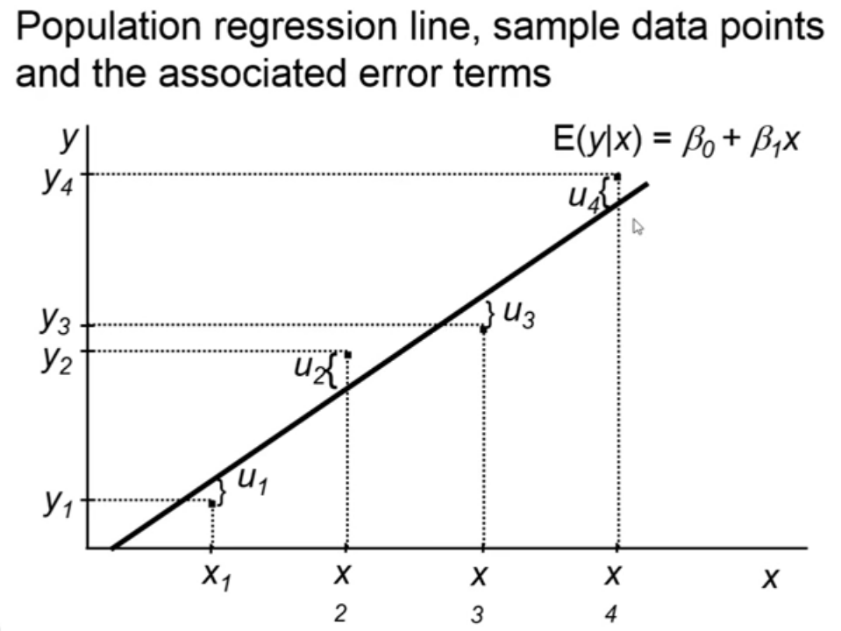
…
The gap between actual value & fitted line is ERROR

Slide 4
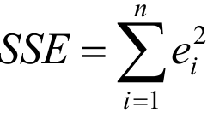
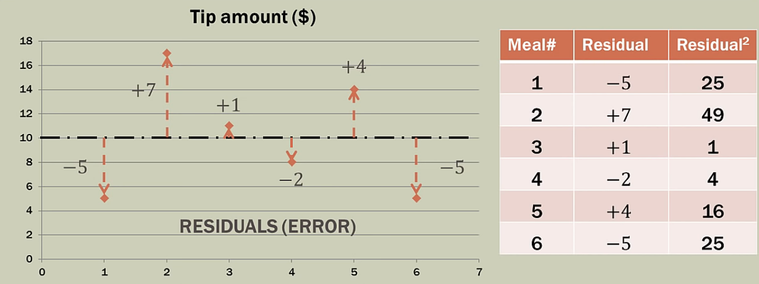

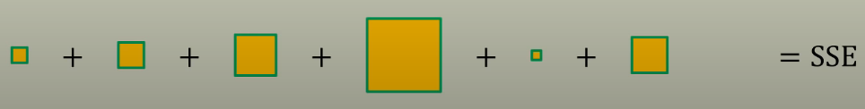
SSE:
These residuals can be summed in the sum of squared errors (SSE).

Slide 5
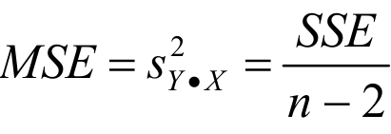
MSE:
Mean-square-error (MSE)
or called "error variance".
where, “Sy” is Standard Deviation of Y.
where, “X” is Independent Variable.
where, “n” is number of observed value.

Slide 6
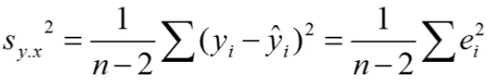
RMSE:
Root-mean-square-error (RMSE)
or called "Standard Error of the regression".
where, “Sy” is Standard Deviation of Y.
where, “X” is Independent Variable.
where, “n” is number of observed value.

Slide 7




EXAMPLE’S OF SSE, MSE & RMSE:
for example, if SSE is :
and "n” number of observations are :
then, MSE will be as :
also, RMSE have that :

Slide 8
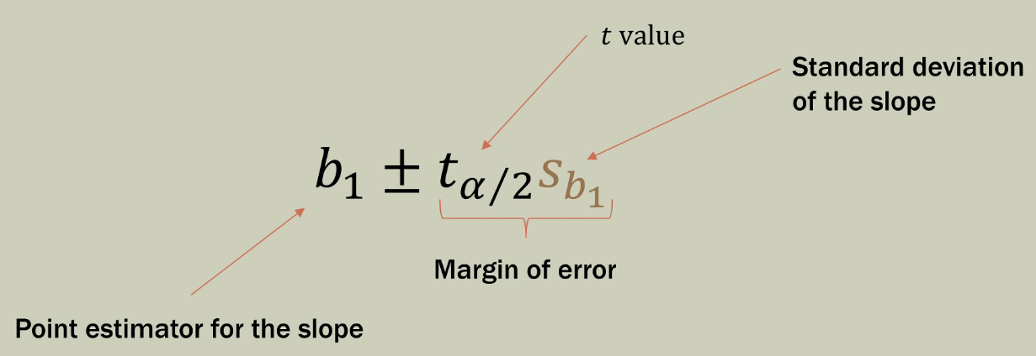
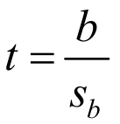
UNCERTAINITY IN REGRESSION PARAMETERS:
CI (COFIDENCE INTERNAL) FOR SLOPE:
to determine whether the slope of the regression line is statistically significant, one can straightforwardly calculate t :

Slide 9
…
where, “b” is Slope of the regression line.
where, “Sb” is Standard Error of the slope.
finally, we conclude mathematically :

Slide 10
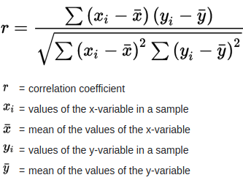
‘ r ’ ( Correlation Coefficient ) :
It is based on two variables :
1) Dependent Variable ‘Y’.
2) Independent Variable ‘X’.

Slide 11
Conditions for value of ‘ r ’ :
It’s value range between -1 and 1.
If it’s value lesser than -1 then there was an error.
If it’s value greater than 1 then there was an error.
If it’s value is 0 shows no linear relationship.

Slide 12
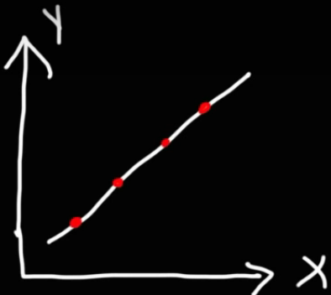
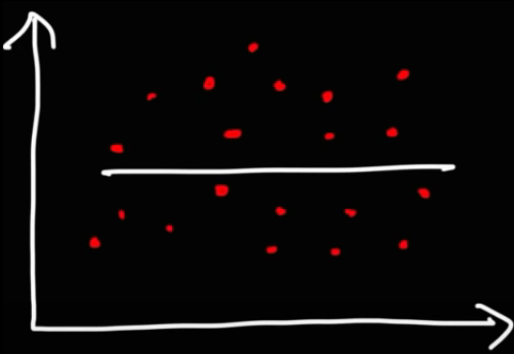

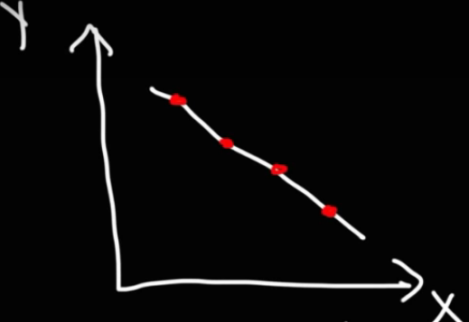

Possible values of ‘ r ’ :
r = +1
r = -1
r = 0

Slide 13
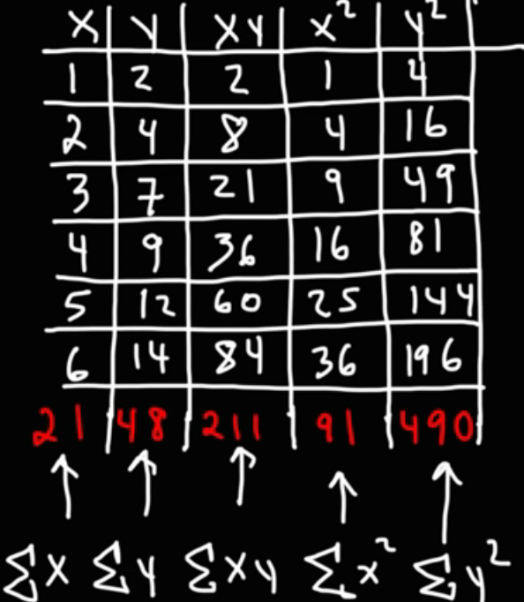

…
Solution :
For example:
Calculate “ r ” between X & Y variables :

Slide 14
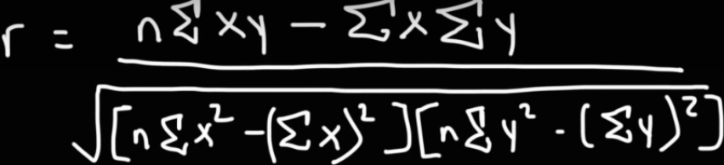

…
Using formula of ‘ r ’ :
After solving mathematically :

Slide 15




….
This latter uncertainty is simply the standard deviation of the residuals, or Y X s • , which is added (in quadrature) to the uncertainty in Yi à , as follows:
The standard error of the Y-intercept, a, is just a special case of (20) for Xi=0
The standard error of the correlation coefficient r is,
We can test whether the correlation between X and Y is statistically significant by comparing r to its standard error,

Slide 16
ASSUMPTIONS OF LINEAR REGRESSION:
1- The simple linear regression model is linear in parameters. 𝒀_𝒊=𝜶+𝜷𝑿_𝒊+𝜺_𝒊
2- The X values are fixed or predetermined i.e. the X values are non-random.
3- The X values must not be all same i.e. there should be variation in X values and they should have non-zero variance.
4- The error term has zero mean or the expected value of error term is zero. 𝑬(𝜺_𝒊 )=𝟎
5- The error term has variance equal to 𝛔^𝟐 (Constant variance or error term) it is known as Homoscedasticity (Equal variance).

Slide 17
…
7- The error terms are independent of each other
𝑬(𝜺_𝒊 〖,𝜺〗_𝒋 )=𝟎=𝑪𝒐𝒗(𝜺_𝒊 〖,𝜺〗_𝒋 ) 𝒊≠𝒋
There is no autocorrelation or serial correlation between error terms It means that two different series of error terms or different distribution of error term at different levels of X are independent of each other.
8- There is no relationship between error term and X variable (𝜺_𝒊 𝑿_𝒊 )=𝟎

Slide 18
REGRESSION MODEL:
Steps of constructing good regression model
1.Selection of variables
2.Spliting Data
1-VARIABLE SELECTION:
When we are selecting X variable we need to ensure that chosen X variable Complement the Y variable but are not substitutable among each other.
Predictor
Predicated
Choosing a predictor is an important step in regression model.

Slide 19
…
Step 1:
Choosing variables that are correlated (i.e. complementary) with the target variable
Step 2:
Ensuring that X variable are not highly correlated amongst one another(i.e. not redundant)
2-SPLITING DATASET:
Split the data into two part

Slide 20
….
Training
Testing
Training:
Its is used to built the model.
Testing:
It is used to evaluate the model

Slide 21
E-COMMERCE PROJECT’S DEMO:
ABOUT THE PROJECT:
An E-Commerce based company in NEW-YORK.
It sells clothing online.
It also has in-store style and clothing advice sessions.
SERVICES FOR CUSTOMERS:
Customers can have meetings or sessions with personal stylist.
And then can go home and order either on a mobile app or a website.

Slide 22
COMPANY IS TRYING TO DECIDE!!!
Whether to focus their efforts on:
Mobile App?
Or
Website?
in order t flourish and prosper their business.

Slide 23
MOBILE APPS VS WEBSITES:
Studies have shown that:
MOBILE APPS cater to better user experience as compared to WEBSITES.
WHY?
Because Mobile Apps are:
More convenient.
Perform a task better with the help of gestures.
Loads contents faster.
Easier to use.
Push notifications.
Brand presence in device of user.
No connection needed.

Slide 24
LINEAR REGRESSION MODEL IN THIS E-COMMERCE PROJECT:
LINEAR REGRESSION MODEL is used for:
Is used to predict values of one variable from values of another, for which more data are available.
LINEAR REGRESSION MODEL is used in this E-Commerce project for:
Training the model.

Slide 25
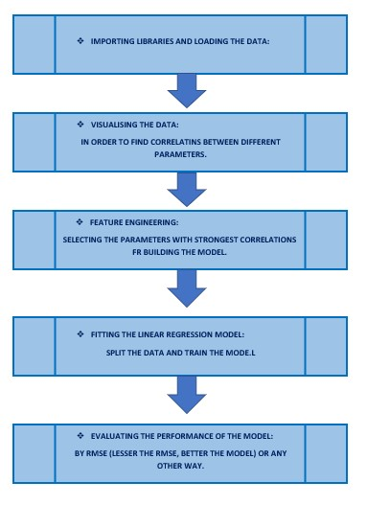
STEP BY STEP APPROACH TO USE LINEAR REGRESSION MODEL:

Slide 26
E-COMMERCE PROJECT:
THE STEP BY STEP APPROACH OF THIS PROJECT IS AS FLLOWS:
1. Imported libraries
2. Getting the data
from the CSV File of E-Commerce customers.
Attributes of that CSV File are:
Email
Address
Color Avatar
Avg. Session Length(in minutes).

Slide 27
…
Time on APP(in minutes).
Time on Website(in minutes).
Length of Membership.
3. Reading the data from CSV file.
4. Describing some methods on the data.
5. Exploring the data:
In this step joint plots are created in order to compare the
YEARLY AMOUNT SPENT (Y-AXIS).
Vs
TIME ON WEBSITE/APP (X-AXIS).

Slide 28
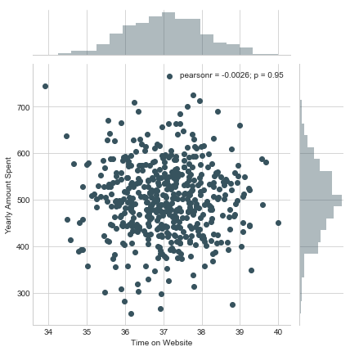
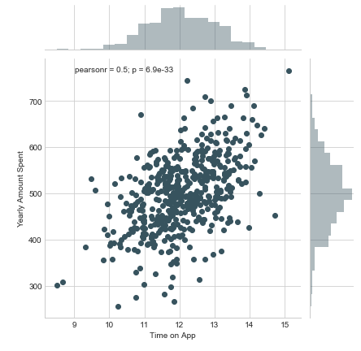
CORRELATIONS:

Slide 29
…
BY COMPARING BOTH THE CORRELATIONS:
It is observed that correlation of time on website with yearly amount spent is more strong as compared to time on mobile app.
SO,
From here it also gives idea t go for a
MOBILE APP!

Slide 30
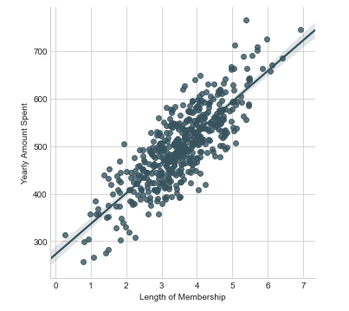
…
6. EXPLORING THER RELATINSHIPS by using PAIR PLOTS.
(From the document..)
It is observed that
The most correlated feature with YEARLY AMOUNT SPENT is LENGTH OF MEMBERSHIP.

Slide 31
7. TRAINING AND TESTING DATA:
After observing this correlation:
Create a linear model of YEARLY AMOUNT SPENT AND LENGTH OF MEMBERSHIP.
After exploring, split data into training and testing sets.
Import LINEAR REGRESSION from sklearn.linear_model and train the data.
In training phase where you train algorithms to create the right output.
It learns the values of coefficients from the model.

Slide 32
SPLITTING THE DATA:
WHY TO SPLIT DATA?
Data is a heart of every machine learning problem.
Training a model is first step in making good predictions.
Splitting data is therefore necessary to build a solid basis t train and test a model.
HOW TO SPLIT DATA?
The data should be divided int three sets:
Training dataset.
Validation dataset.
Testing dataset.

Slide 33
…
TRAINING DATASET:
It is used to tarin the model.
This should be the largest portion of dataset.
Features are extracted and trained to fit a model.
Our model learns from this data.
For example:
Regression model would use examples in this data to find coefficients(gradients).

Slide 34
…
VALIDATION DATASET:
REQUIRED! If you test several models.
Is used t validate the trained model.
It’s the most important setting as it will form basis of our model evaluation.
If the difference between error n training set and error on validation set is huge, it means the model as high variance and hence the case of over-fitting.

Slide 35
…
TEST DATASET:
Here we test the trained and validated model.
It tells us how efficient our overall model is! And how likely is it going to predict something which does not make sense.
Data splitting:
If we have only one model, a good approach is to split data into two parts:
Training dataset (80%) and
Testing dataset (20%).

Slide 36
…
But if we have several models…
We have to break them into three datasets:
Training data set (70%).
Validation and Testing dataset (equal parts).
So in this case we can not assume a model to be best n the accuracy of validation dataset because
The model maybe benefited from random patterns in split dataset.
Fr this reason we need to repeat validation step with test dataset in order to select the best model.

Slide 37
8.PREDICTING TEST DATA:
Using lm.predict function and passing parameter of x_test that are the predicted values.
Lm.predict function is used to predict values based on given dataset.
Then, we will plot a scatter graph, using plt.scatter function and passing parameters of y_test and predictions where y_test are the numerical features of the customer and on the horizontal axis and predictions are the yearly amount spent and on vertical axis.
Using matplot library scatterplot is plotted.
The graph demonstrates linear relation between x and y, where x are the real values and y are the predicted values.

Slide 38
EVALUATING THE MODEL:
Now calculate mean absolute error, mean squared error and root mean squared error.
Residuals
It is the vertical distance between datapoint and regression line. It is used to estimate the errors. Datapoint has one residual. It plays an important role in validating the regression model.
Residual is positive if it is above the regression line and it is negative if it is below the regression line.
ŷ (predicted value) is on horizontal axis and residuals are on vertical axis.

Slide 39
CONCLUSION:
Through all the data we conclude that mobile app is working better than website. Two ways can be used :
To develop website to catch up to the performance of the mobile app.
To develop mobile app more because that is working better.
COMPANY SHOULD DEVELOP ITS MOBILE APP
IN ORDER TO GET MORE CUSTOMERS
AND FLOURISH THEIR BUSSINESS!

Slide 40

THANKS ☺

